Slide 1
Week 2
Structure of this lab:
Quiz: 10 minutes (DIY)
R programming tutorial

Slide 2
Quiz
Please use the first 10 minutes of the lab to complete your quiz

Slide 3
R programming
Data types: A variable can store different types of values such as numbers, characters etc. These different types of data that we can use in our code are called data types.
How do I know the data type of the variable? (class function)

Slide 4
Data types
Logical
Numeric
Integer
Complex
Character
Raw

Slide 5
Logical Data type
Logical data type is also knows as Boolean.
In Java we have true and false.
Similarly, in R we have “TRUE” and “FALSE”.
You don’t need to type the whole word to assign a logical value to a variable.
is_weeked <- F also does the job!

Slide 6
Numeric Data Type
Represents all real numbers with or without decimal values.
Numeric data type is the default data type for numbers in R.
For example: weight <- 83.5. Here class of weight is numeric.
What is the result of
a <- 0.0001 + 1.1?
a <- “a” + 2

Slide 7
Integer
Specifies real values without decimal points.
We use the suffix L to specify integer data.
Eg: int_var <- 3120L

Slide 8
Complex
Used to store imaginary values in math.
We use the suffix i to specify the imaginary part.
Eg: complex_var <- 3120 + 1i

Slide 9
Character data type
Used to specify character or string values in a variable.
A string is asset of characters. Eg: ‘A’ is a character while “Apple” is a string.
It is important to note the convention quotes for representing strings and characters.
Eg: string_var <- “Apple”

Slide 10
Raw Data type
A raw data type specifies values as raw bytes. You can use the following methods to convert character data types to a raw data type and vice-versa:
charToRaw() - converts character data to raw data
rawToChar() - converts raw data to character data

Slide 11
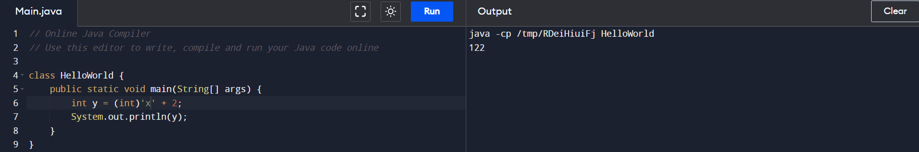
Data types
What will be the result of the following operations?
x <- “a”; y <- x + 1 ?
How to make this work in R?
We have uft8ToInt() function since we can’t directly type cast.

Slide 12
Strings
strsplit() – Used to split string on a delimiter.
grepl() - Check for an expression in a string.

Slide 13
Some important concepts
%in% - Python in function represented in R.
string_1[string_1 %in% string_2] Return common elements in two character string vectors.
Enhanced if else: ifelse(string_1 %in% string_2, “Yes”, “No”)

Slide 14
Importance of Grammar
A way to express the structure of a language formally.
Helps the language designer clarify and communicate the structure.
Helps us better understand the syntax and semantics of the language.
Makes it easier to implement a complier or interpreter.

Slide 15
Expressing a Grammar
Backus Naur Form: Terminals are simply written out: while
Non terminals are enclosed in angle brackets: <statement>
Productions define these terminals and non terminals.
<nonterminal> ::= <sequence of terminals or non terminals>
<sentence> ::= <noun phrase><verb phrase>
We can use | to represent or

Slide 16
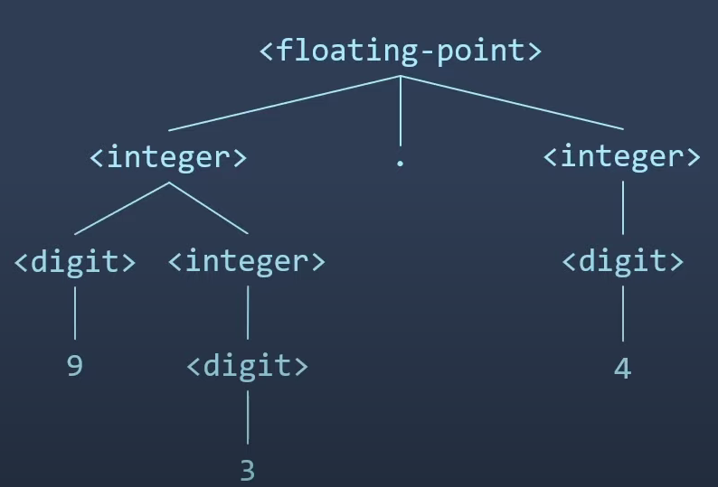
Simple Example
<digit> ::= 0 | 1| 2| 3 | 4 | 5 | 6 | 7 | 8 | 9
<integer> ::= <digit> | <digit><integer>
<floating point> ::= <integer>.<integer>
Parse tree for a floating point

Slide 17
BNF of R control structures
<statement> ::= <if-statement> | <while-statement> | <assignment>
<assignment> ::= <variable> <- <expression>
<if-statement> ::= if(<condition> <statement>) |
if(<condition> <statement>) else <statement>
<while-statement> ::= while(<condition>) <statement>

Slide 18
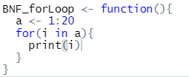
Simple exercise
What would the BNF for this
function be like?
<statement> ::= a -> 1:20
<for-loop> ::= for(i in a)
<statement> ::= print(i)

Slide 19
Scope of R
Can I use R for developing an OS?
R is an interpreted language, meaning, program doesn’t get fully translated into machine code.
So, if you want to write a software that interacts with the operating system, you should choose a language that gets compiled into a code that a machine can understand.
Hence, developing an R compiler should be step 1.
Or write a R interpreter that runs directly on the computer’s hardware without using the OS.
One example of this is PHP. Facebook has developed a PHP compiler, although not open source.

Slide 20
Lists in R
Lists are the R objects which contain elements of different types like − numbers, strings, vectors and another list inside it.
A list can also contain a matrix or a function as its elements.
List is created using list() function.
Eg:
list_data <- list("Red", "Green", c(21,32,11), TRUE, 51.23, 119.1)

Slide 21
Dictionary in R
install.packages(“Dict”)
Dict is an R package which implements a key-value dictionary data structure.
It is designed to be similar usages with other languages’ dictionary implementations (e.g. Python).

Slide 22
Instantiate an R dictionary
install.packages(“Dict”)
Please refer to this official documentation on the methods available when working with Hash functions in R.
Common errors:
Rlang error: use this command:
install.packages(“Dict”, type = “binary”)

Slide 23
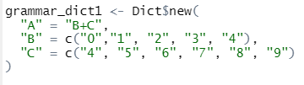
Creating your own dictionary

Slide 24
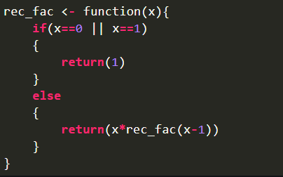
Recursion
Recursive functions call themselves. They break down the problem into smaller components. The function() calls itself within the original function() on each of the smaller components. After this, the results will be put together to solve the original problem.

Slide 25
Some exercises
Write a program to negate the function %in%. Hint: There is a function called Negate(). Look at what you can pass in it to obtain a desired value.
Create a dictionary like with the following key value pairs. Calculate the factorial of each of the following value using recursion.
Hint: Google on how to traverse and access the keys of a dictionary. Then. Store these values in a vector and call factorial function.
Key | Value
1 | 5
2 | 6
3 | 15

Slide 26
References
Handling strings in R
String operations
R

